Slide 1
Strain Gauge

Slide 2
Strain Gauge
A strain gauge is a passive transducer, that converts mechanical displacement into the change of resistance.
Strain gauges are devices that are commonly used by engineers to measure the effect of external forces on an object.
Strain is measured directly, which can be used to indirectly determine stress, torque, pressure, deflection, and many other measurements.
Strain is a dimensionless measurement.
It is a ratio of the change in length to the original length of an object.
Stress is a measurement of the force applied divided by the initial cross-sectional area of an object, or the internal resisting capacity of an object.

Slide 3
Types of Strain Gauge
Wire Wound strain Gauge
Bonded
Unbonded
Foil type strain gauge
Semiconductor strain gauge
Capacitive strain gauge

Slide 4
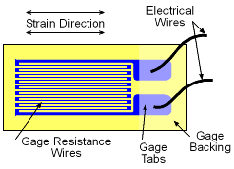
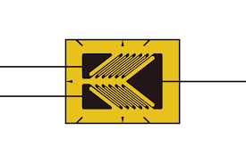
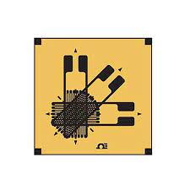
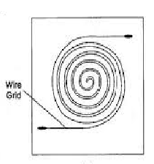
Wire wound Strain Gauge
Bonded strain gauge is cemented on a resilient insulating support, usually a wafer unit
Linear Strain Gauge
Torque Gauge
Rosette
Helical

Slide 5
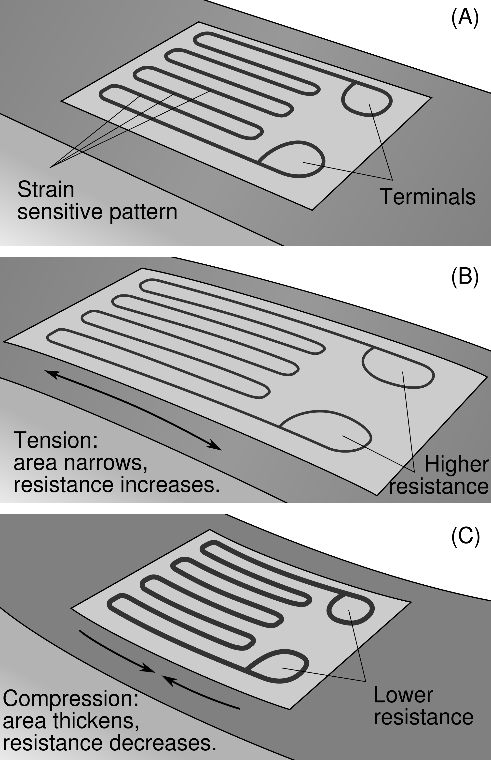
Strain Gauge

Slide 6
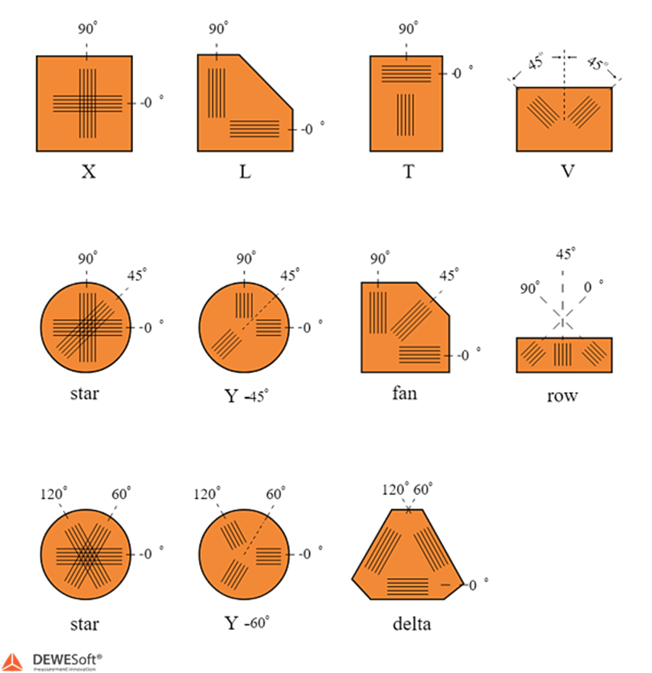
Types of Rosettes
Strain Gauge Rosettes

Slide 7
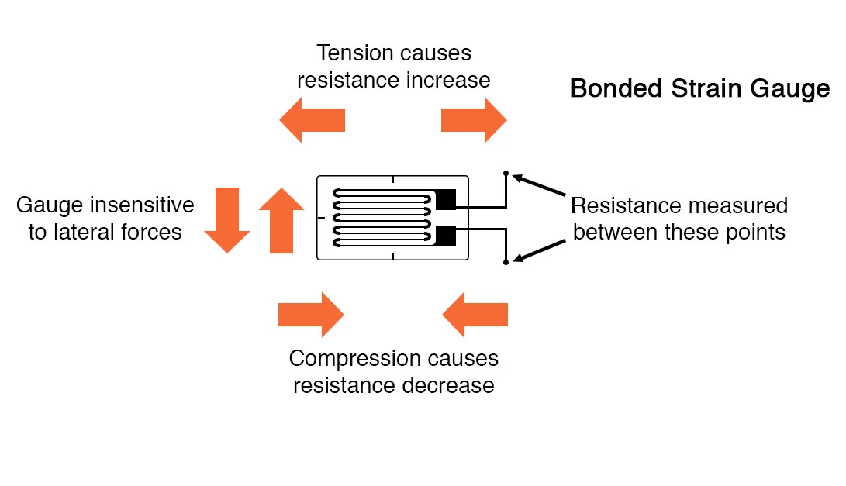
Strain Gauge

Slide 8
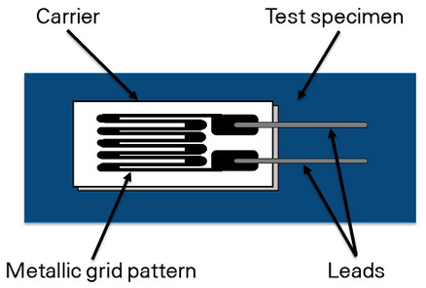
Strain Gauge

Slide 9
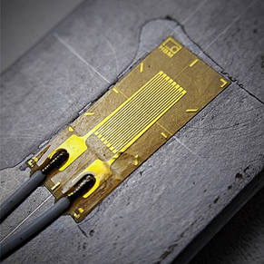
Strain Gauge

Slide 10
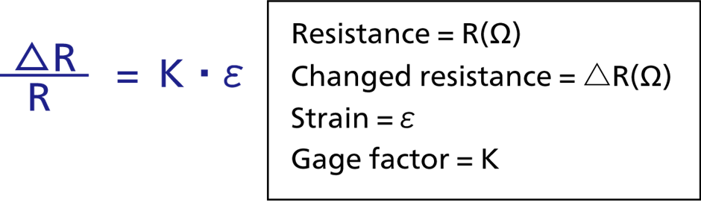
Strain Gauge
Fig:- Gauge Factor Equation

Slide 11
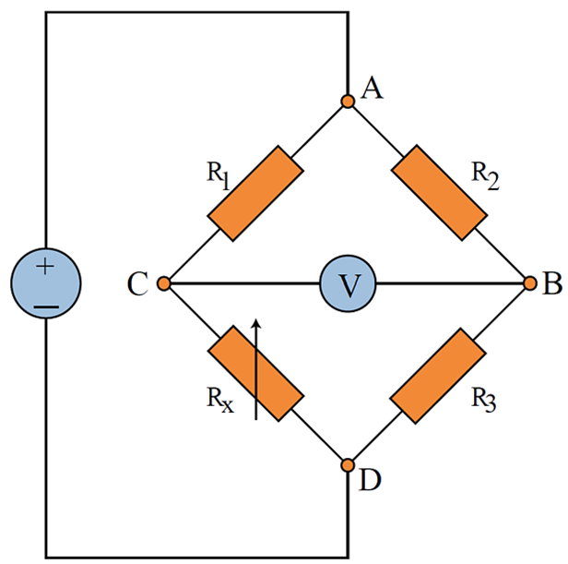
Types of Strain Gauge
Quarter Bridge Strain Gauge

Slide 12
Foil Type Strain Gauge
The strain is sensed with the help of metal foil.
Foil gauge has much greater dissipation as compared with wire wound strain gauge on account of its greater surface area.
Operated at higher operating temperature range.
Advantages
Excellent strain reproducibility.
Low hysteresis and creep effect.
Excellent mechanical stability
Long life
Easy fabrication

Slide 13
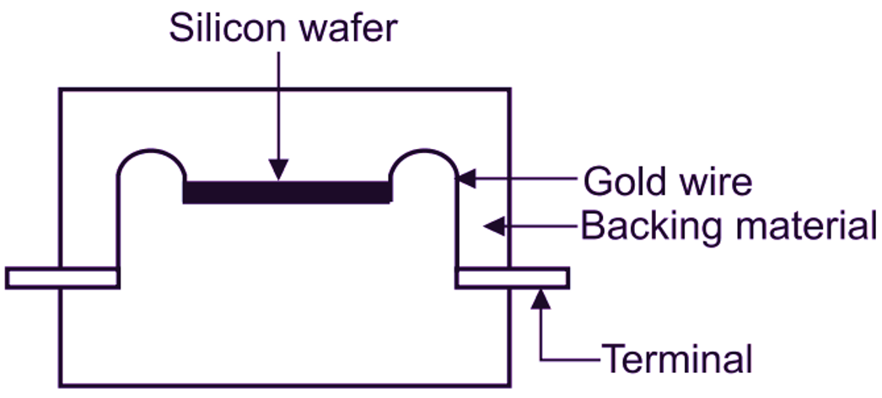
Semiconductor Strain Gauge
Semiconductor Strain Gages. Semiconductor strain gages make use of the piezoresistive effect in certain semiconductor materials such as silicon and germanium in order to obtain greater sensitivity and higher level output. Semiconductor gages can be produced to have either positive or negative changes when strained.
Two types of semiconductor strain gauges
Negative or n-type, whose resistance decreases in response to tensile strain.
Positive or p-type, whose resistance increases in response to tensile strain.

Slide 14
Semiconductor Strain Gauge
Advantages
These gauges have high gauge factor and hence they can measure very small strains.
They can be manufactured to very small sizes.
They have excellent hysteresis characteristics.
They have a good frequency of response.
Chemically Inert
Excellent fatigue life
Disadvantages
Very sensitive to temperature change
Linearity is poor

Slide 15
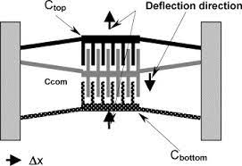
Capacitive Strain Gauge
Capacitance based strain gauges (CSGs) provide a robust sensing mechanism capable of addressing the performance issues associated with resistivity hysteresis of RSGs.
It uses the mechanism of change in capacitance by change in distance between the electrodes.

Slide 16
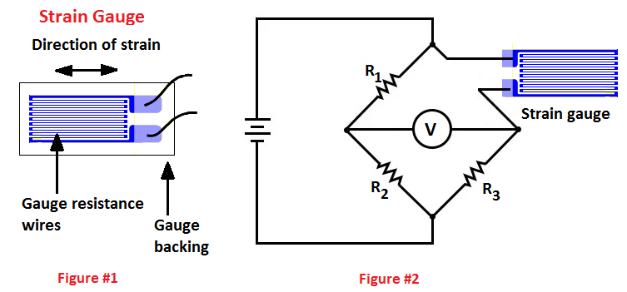
Types of Strain Gauge
Quarter Bridge Strain Gauge

Slide 17
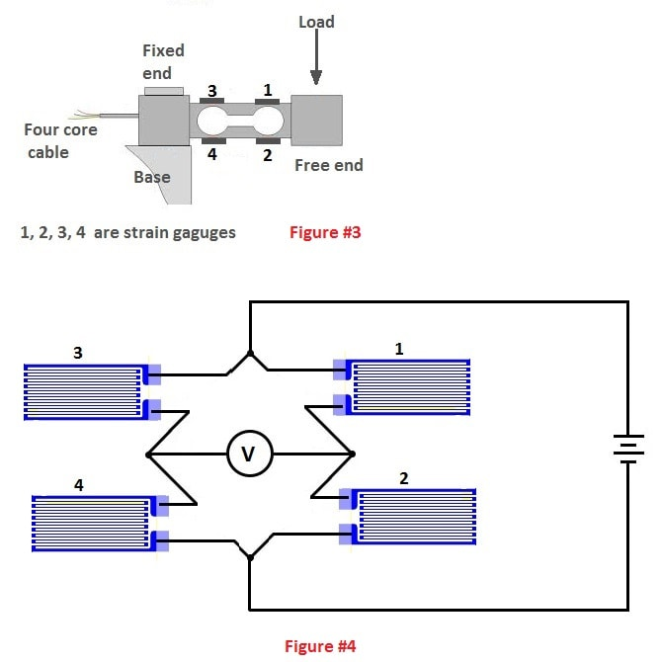
Types of Strain Gauge
Quarter Bridge Strain Gauge

Slide 18
Characteristics of Strain Gauge
For a satisfactory operation a strain gauge should have the following characteristics:
It should have a high value of gauge factor. With the high value of the gauge factor, we can get a high sensitivity of the system.
It should have a high value of resistance as it minimizes the effect of unwanted variations of resistance in the measurement circuit.
It should have low resistance temperature coefficient. It is very necessary to minimize errors due to temperature variations.
It should not have any Hysteresis effects.
It should have linear characteristics. variations in resistance should always be proportional to the variations in the strain.
Hysteresis. The output of a transducer not only depends upon the input quantity but also upon input quantities previously applied to it.

Slide 19
Advantages of Strain Gauge
High measurement sensitivity and precision. The minimum strain reading is 1με (microstrain, 1με = 1 × 10-6ε). The accuracy can reach 1 ~ 2% when measured at room temperature.
Wide measurement range.
The frequency response is good. Dynamic strain can be measured from static to hundreds of megahertz.
The size of the strain gauge is small and the weight is light. The smallest strain gauge grid can be as short as 0.1 mm, which is easy to install and will not affect the stress state of the component.
Output electrical signals during measurement.
It can be measured in various complicated environments. Such as high, low temperature, high speed rotation, strong magnetic fields and other environmental measurements.

Slide 20
Disadvantages of Strain Gauge
Only the surface strain of the component can be measured, but not the internal strain of the component.
A strain gauge can only measure the strain of a point on the surface of a component in a certain direction, and cannot perform global measurement.
The output is non-linear
Sensitive to temperature
Regular caliberation is required

Slide 21
Applications of Strain Gauge
Geotechnical monitoring :- to keep a constant check on structures, dams, tunnels, and buildings so that the mishaps can be avoided well on time.
Aeroplanes:- Strain gauges are fixed to the structural load-bearing components to measure stresses along load paths for wing deflection or deformation in an aeroplane.
Bridges Monitoring:-Instrumentation of bridges is done to verify design parameters, evaluate the performance of new technologies used in the construction of bridges
Railways:-Strain Gauges have a long history in the safety of rails. It is used to measure stress and strain on rails. Strain gauges measure axial tension or compression with no impact on the rails.
Torque and Power Measurements in Rotating Equipment

